Slide 1
FAFSA Simplification – What's Here and What's on the Horizon
Carrie Warick Director of Partnership and Policy National College Access Network
warickc@collegeaccess.org
@CarrieWarick

Slide 2
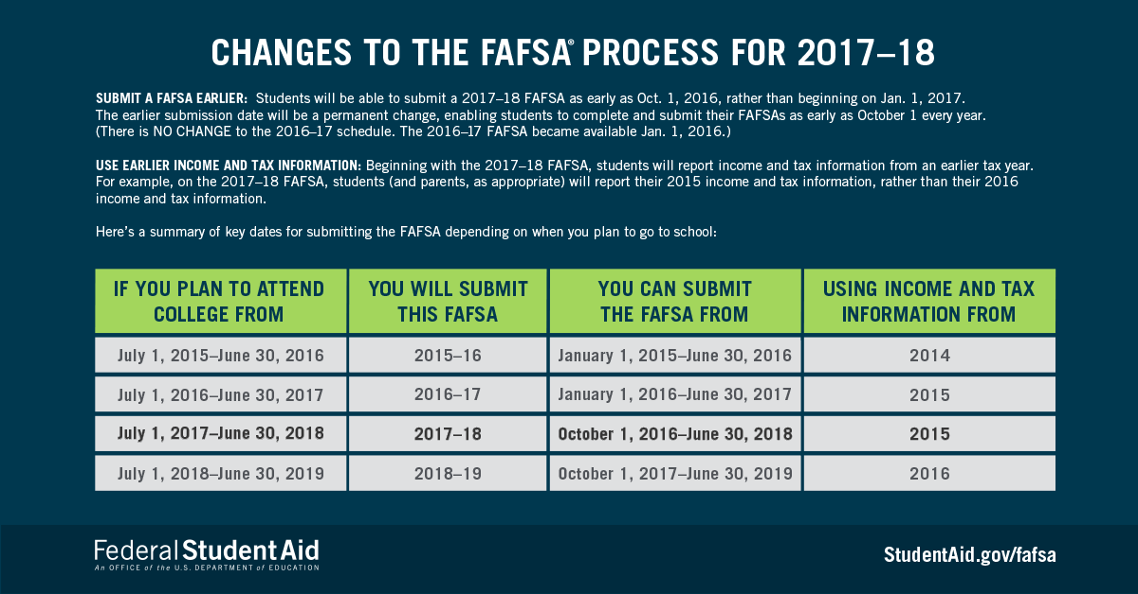
Early FAFSA Starts in October
Notes:
Submit a FAFSA® Earlier: Students will be able to file a 2017–18 FAFSA as early as Oct. 1, 2016, rather than beginning on Jan. 1, 2017.
Use Earlier Income Information: Beginning with the 2017–18 FAFSA, students will report income information from an earlier tax year.
1992 – Free Application for Federal Student Aid (FAFSA)
1997 – FAFSA on the Web
2008 – IRS Data Retrieval Tool (2009-10 FAFSA)
2009 – Skip/Smart Logic (2010-11 FAFSA)
2016 – Earlier Launch & Earlier Income and Tax Information Required (2017-18 FAFSA)

Slide 3
Benefits of FAFSA Changes
Benefit #1: Alignment
Many college application deadlines occur in the fall
Alignment of FAFSA availability = less confusion
Benefit #2: Certainty
No need to estimate tax information
IRS Data Retrieval Tool available at launch
Earlier receipt of Expected Family Contribution (helps with assessing net costs)
Benefit #3: Less Pressure
More time before (most) state and school financial deadlines
More time to compare school offers before College Signing Day

Slide 4
Prior-Prior and Early FAFSA
Information will not carry over in renewal FAFSA
Professional judgment: More is expected
Students CANNOT choose to use 2016 income on FAFSA, must request FAA to review due to change
Pell schedules and campus-based awards
Verification
Use of DRT will reduce selection for verification
Documentation of income/taxes from 2016-2017 can be used for 2017-2018
Notes:
Will the income information carry over in a renewal FAFSA?
Can applicants report 2016 income information instead of 2015?
What if I’ve had a major change (ex. dependency status or marital status) between 2016-2017 and 2017-2018?

Slide 5
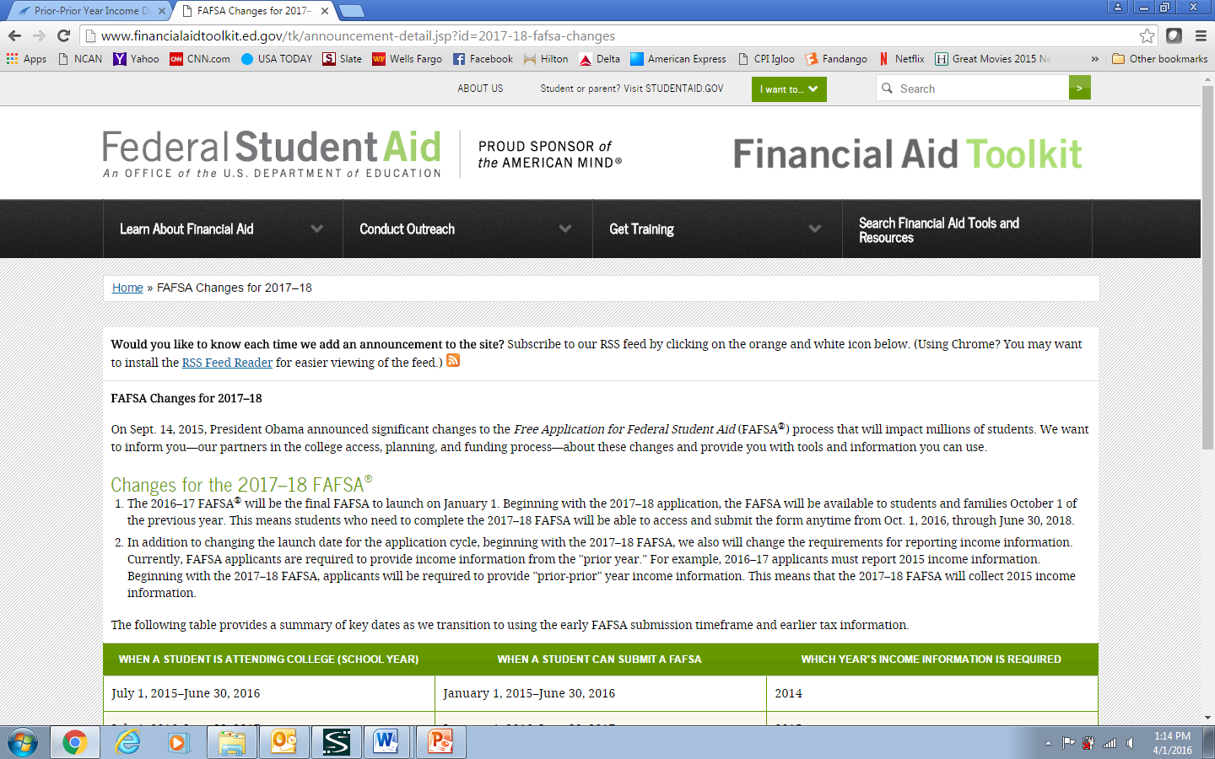
Resources: FSA https://financialaidtoolkit.ed.gov/tk/announcement-detail.jsp?id=2017-18-fafsa-changes

Slide 6
Resources: NCAN, NACAC, NASFAA
National College Access Network: www.collegeaccess.org/EarlyFAFSAResources
National Association of College Admissions Counselors: www.nacacnet.org/ppy
National Association of Student Financial Aid Administrators: www.nasfaa.org/ppy_toolkit

Slide 7
FAFSA Simplification Goals
Stop asking real poor students to prove they are poor over and over again
Improve the user experience when filing the FAFSA
Remove questions not needed for the federal formula and those answered by the fewest number of people

Slide 8
FAFSA Simplification Next Steps
Several groups working on simplification-NASFAA, Gates Foundation and NCAN
Bi-Partisan interest in DC for simplification - the devil is in the details
Common Theme: Different Pathways for Different Applicants
Likely to occur during Higher Ed Reauthorization

Slide 9
NCAN Simplification Process
Take new user experience to actual students
Developing a prototype for user testing this fall
Control Group-FAFSA Demo Site
Will monitor completion time, error rate and student opinions
Estimating costs (Pell) of revised questions
Share findings will colleagues and Congress
Prepare Final Simplification Proposal to submit during Reauthorization Process

Slide 10
Student Demo: from FSA ID

Slide 11
Student Eligibility: Combines School and Housing

Slide 12
Dependency Status: Easier “Who Are My Parents?” Questions

Slide 13
Parent Demographics: Means Tested Benefits Questions

Slide 14
Parent Tax Info: Expand Who Can Access IRS DRT

Slide 15
State Page: New Optional Page

Slide 16
NCAN Approach to Simplification
Three pathways: Means Tested Benefits Applicant/Simple Tax Filers/Families with Tax Schedules
Optional State Question Page
Expanding Those Able to Use IRS Data Retrieval Tool
Used Brain Trust of Experts
Combine User Testing and Research to Make Final Recommendation

Slide 17
National FAFSA Campaign
Rebranding of College Goal Sunday to be announced in September
Provide tools for local, regional and/or state FAFSA Completion campaigns or assistance workshops
Brand will be open source: any entity that does not charge students a fee may use it

Slide 18
Questions?
Carrie Warick Director of Partnership and Policy National College Access Network
warickc@collegeaccess.org
@CarrieWarick

